Slide 1
Branching
AI2C Tech Intro

Slide 2
Objectives
Utilize branching to manage changes to a git repository
Discuss the different merge strategies
Resolve merge conflicts

Slide 3
Git Review
Repository
Staged vs unstaged
Commit
Diff?

Slide 4
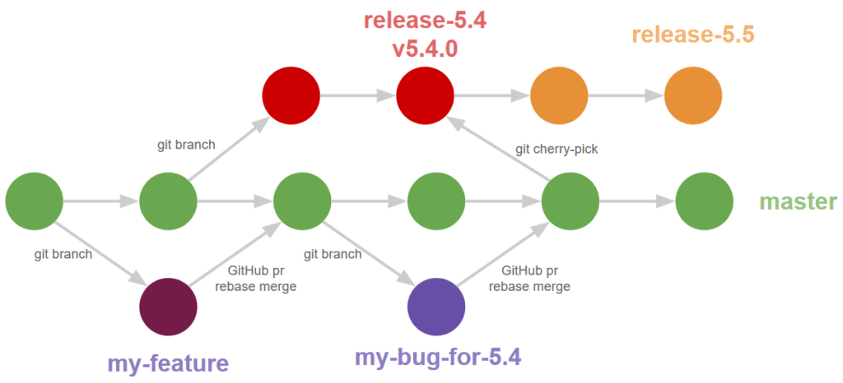
Branches
Repositories are a tree-like structure
Trees have branches
Branches are made off of the trunk, or other branches

Slide 5
Why branch?
Parallel work
Safe experimentation
Protect the main branch

Slide 6
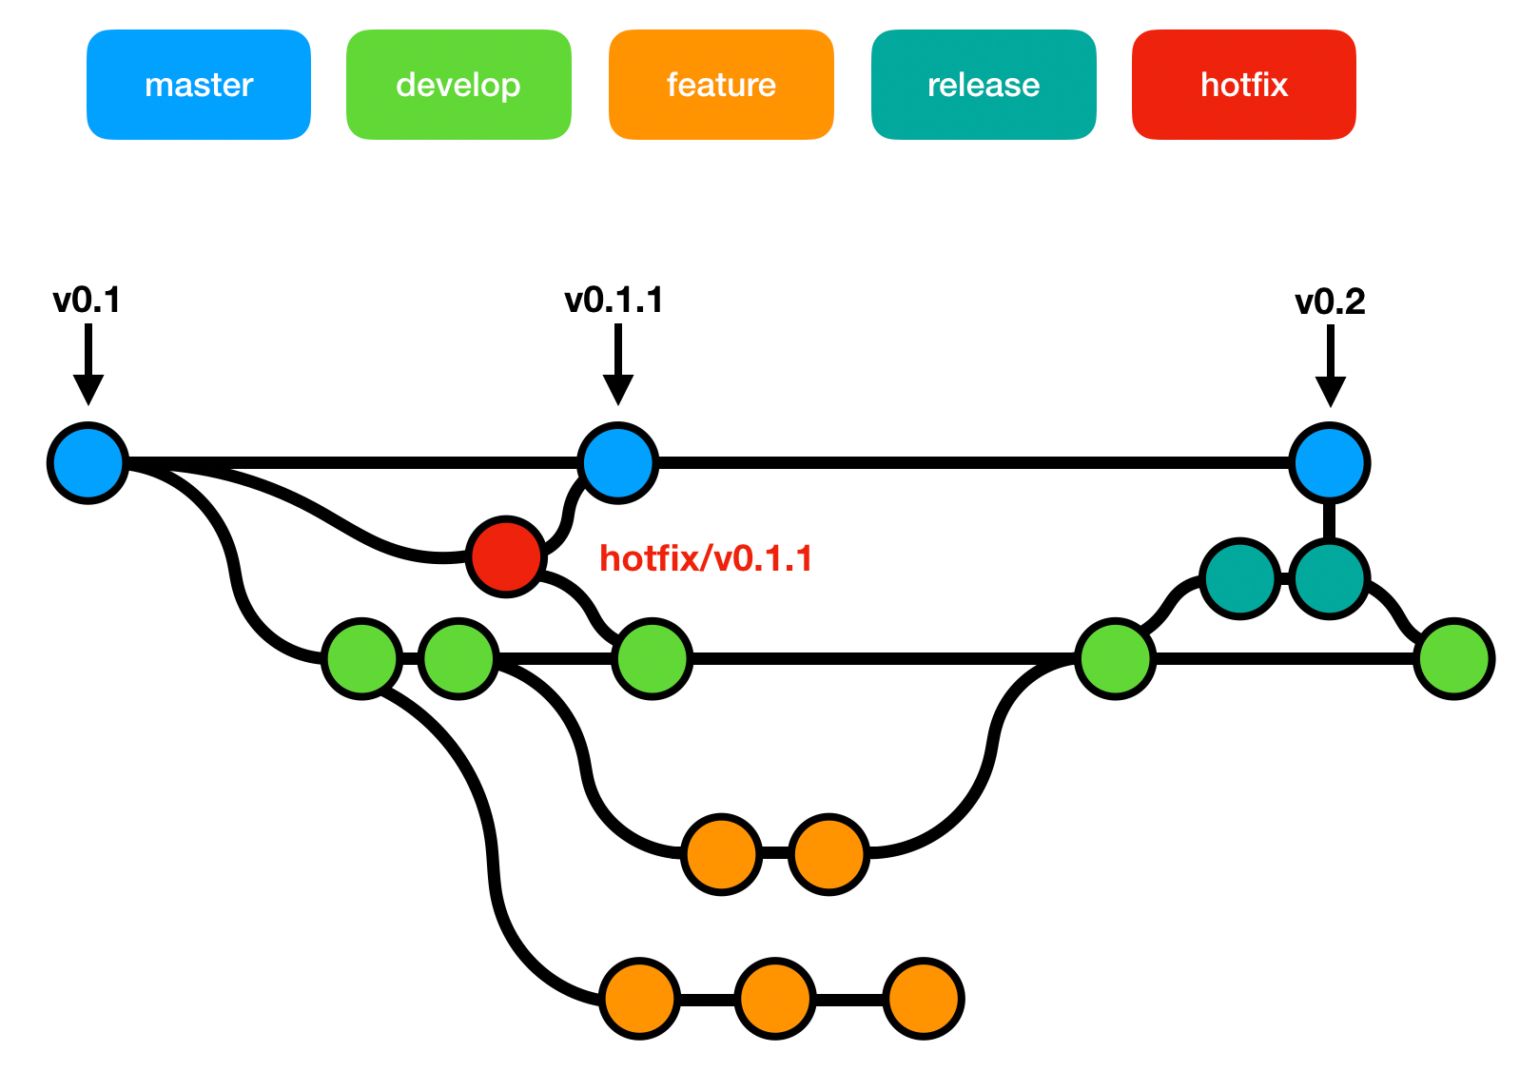
“Normal” branches
Main
Develop
Feature
Bugfix
Release
Hotfix

Slide 7
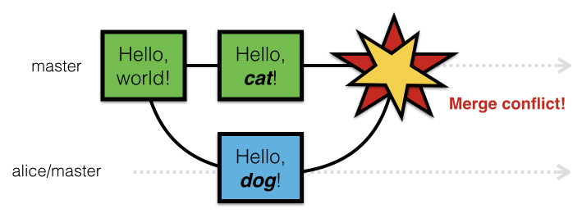
Conflicts

Slide 8
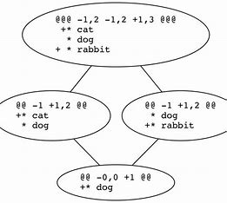
After resolving?
Git add / commit

Slide 9
Reading Conflicts (They’re not scary)
<html>
<head>
<title>Merge Conflict</title>
</head>
<body>
<<<<<<<<<< HEAD
Hello.
========
<strong>Hello.</strong>
>>>>>>>>>> 17c860612953c0f9d88f313c8dfbf7d858e02e91
</body>

Slide 10
Reading Conflicts (Resolution)
<html>
<head>
<title>Merge Conflict</title>
</head>
<body>
Hello.
</body>
<html>
<head>
<title>Merge Conflict</title>
</head>
<body>
<strong>Hello.</strong>
</body>
OR

Slide 11
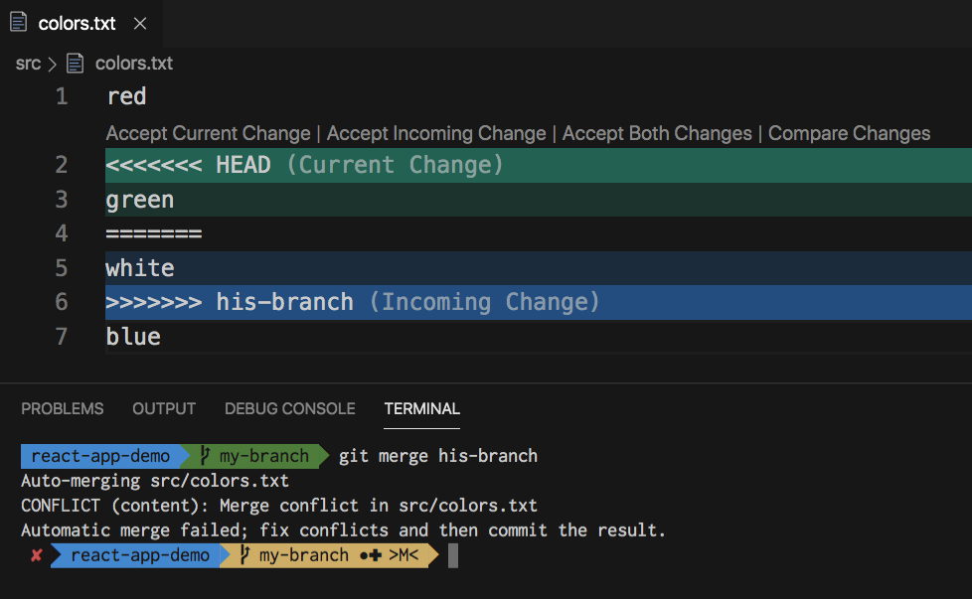
Reading Conflicts (Pretty Colors)

Slide 12
Git checkout / Merge
Command | Description
git checkout –b feature-a git switch –c feature-a | Create a new branch and switch to it
git checkout feature-a | Switch to an existing branch
git merge feature-a | Merge the specified branch onto the current branch using the default strategy (configured)
git merge --squash feature-a | Merge the specified branch but do not commit the merge

Slide 13
Hands-On #1
Make and merge branches
Resolve conflicts

Slide 14
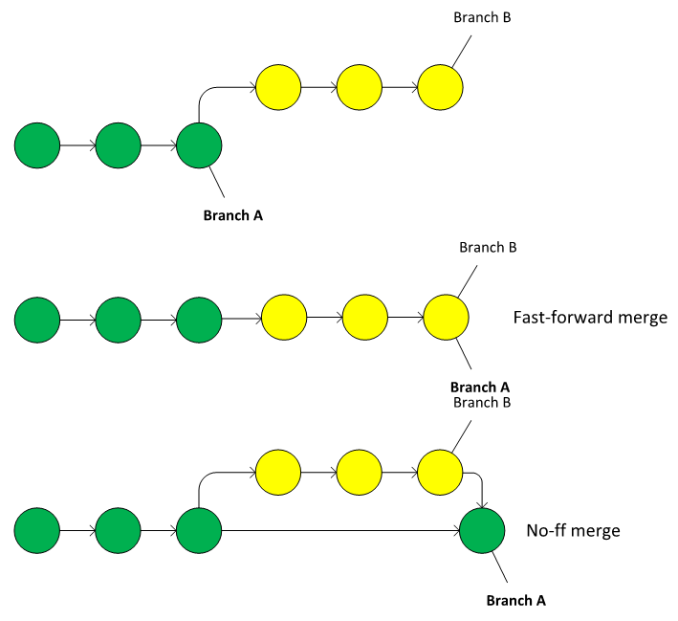
Merging Strategies
Fast-forward applies all commits onto the other branch
--no-ff keeps the branch history and creates a merge commit with all changes
--squash acts like a merge, but never creates the commit
Notes:
https://lukemerrett.com/different-merge-types-in-git/

Slide 15
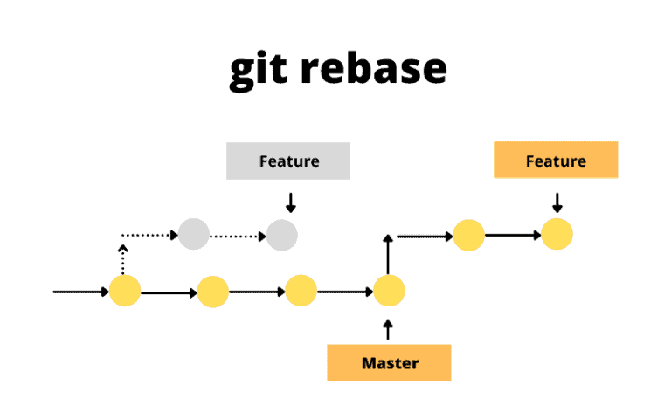
Rebasing
Rebasing reapplies the current branch onto the target branch in order.

Slide 16
Viewing Branches
Git for Windows has tig built-in
VS Code has branch visualization extensions
Using "true merge": https://github.com/vuejs/core/network
Full feature / fix / release branches: https://github.com/jetty/jetty.project/network
Using squash / ff commits: https://github.com/shafe123/cmu-aegis-scholar/network

Slide 17
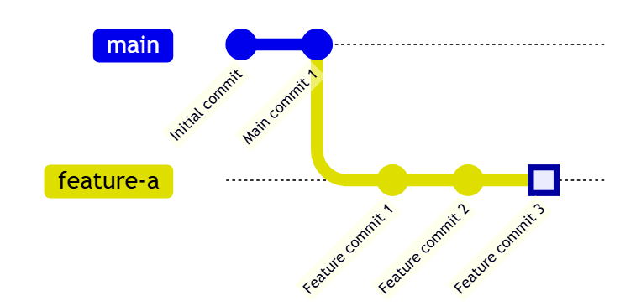
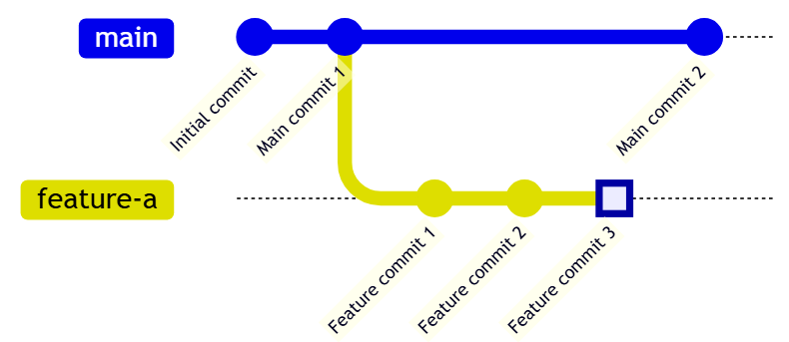
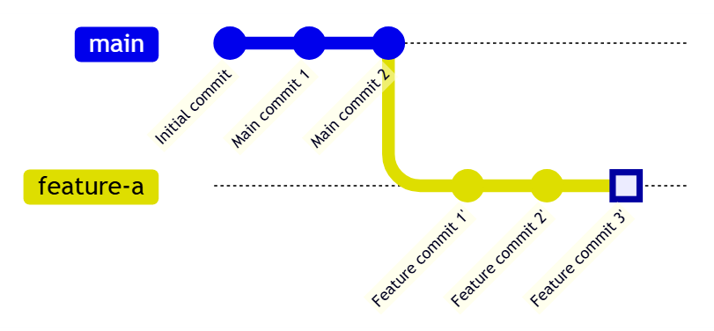
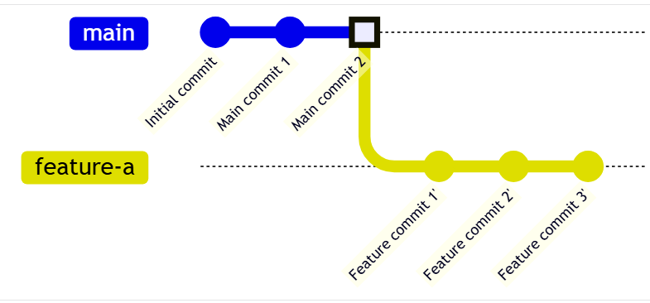
One strategy (feature branch)
Start Point
git fetch
git rebase main
git fetch
git rebase main
git checkout main
git merge --squash feature-a
git commit -m “feature-a”
git checkout main

Slide 18

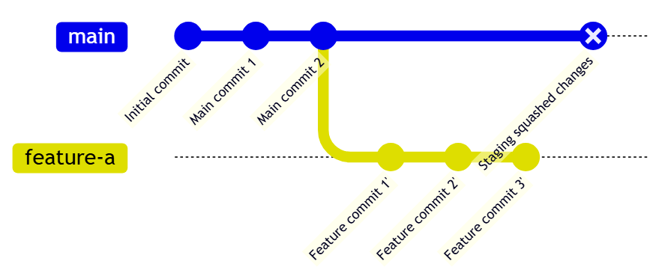
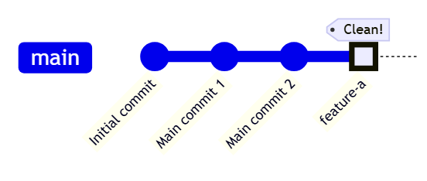
One strategy (feature branch)
git checkout main
git merge --squash feature-a
git fetch
git rebase main
git checkout main
git merge --squash feature-a
git commit -m “feature-a”
git commit -m "feature-a"

Slide 19
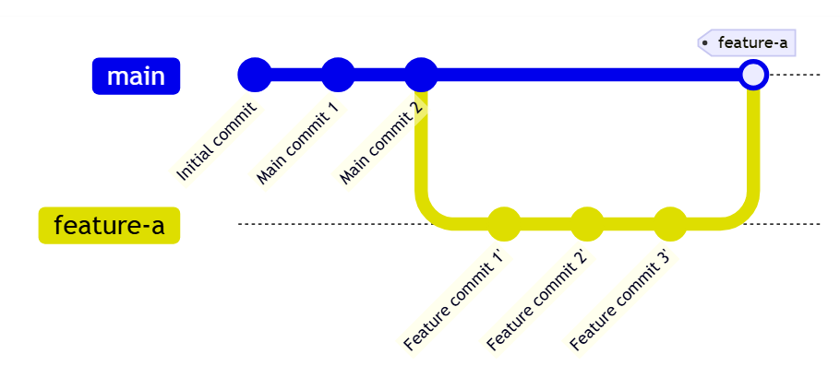
Alternate strategy (feature branch)
git checkout main
git merge --no-ff feature-a –m "feature-a
git fetch
git rebase main
git checkout main
git merge --no-ff feature-a

Slide 20
Hands-On #2
Visualize different merging strategies

Slide 21
Git checkout / Merge
Command | Description
git checkout –b feature-a git switch –c feature-a | Create a new branch and switch to it
git checkout feature-a | Switch to an existing branch
git merge feature-a | Merge the specified branch onto the current branch using the default strategy (configured)
git merge --squash feature-a | Merge the specified branch but do not commit the merge

Slide 22
Good Resources
https://git-scm.com/book/en/v2/Git-Branching-Branches-in-a-Nutshell
https://git-scm.com/book/en/v2/Git-Branching-Basic-Branching-and-Merging
https://git-scm.com/book/en/v2/Git-Branching-Rebasing
https://git-scm.com/book/en/v2/Git-Tools-Advanced-Merging

